Slide 1

Forming an ethical position: 1

Slide 2
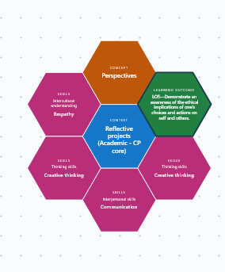
How and why should I form an ethical position?
Thanks to ICS Addis Ababa for the inquiry designer to create this image

Slide 3
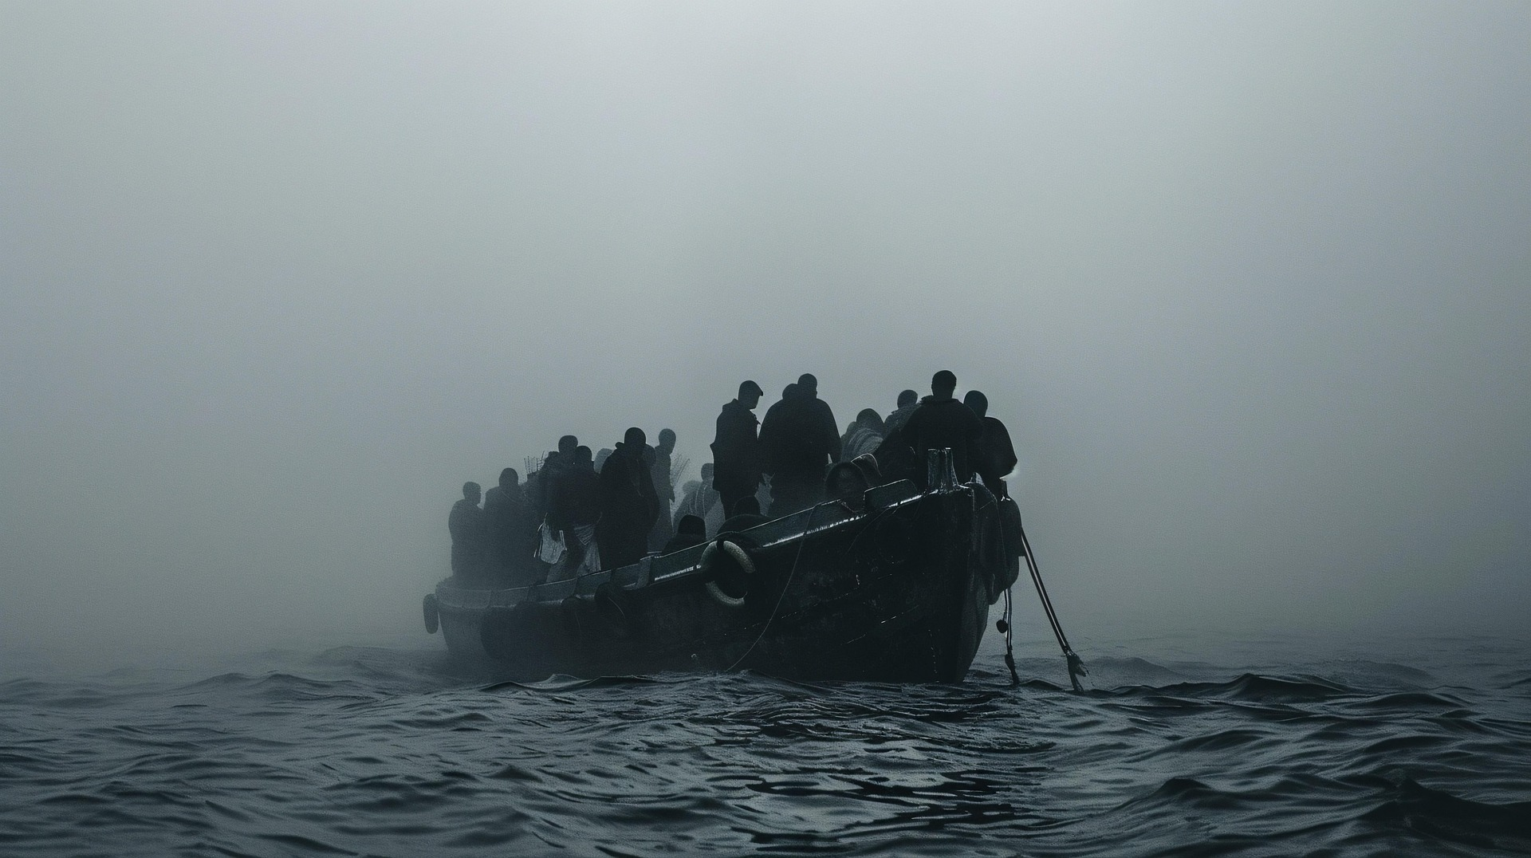
Notes:
Look at this image without saying anything to anyone for at least a minute

Slide 4
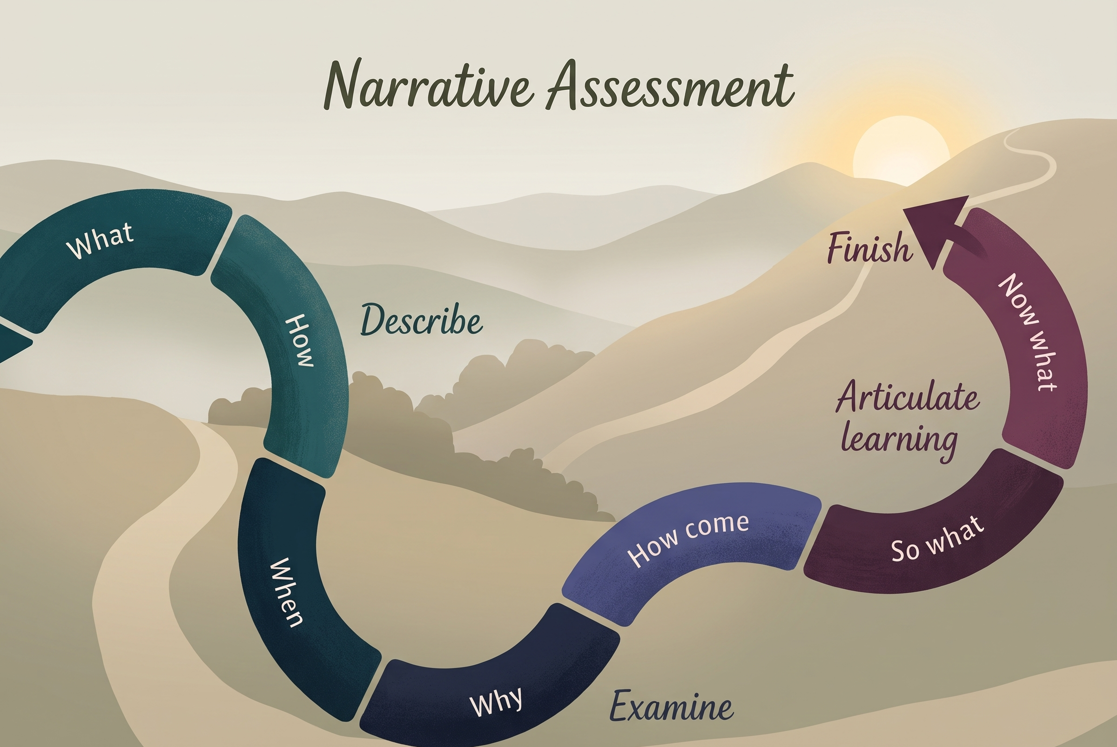
Talk through what you see

Slide 5
First, what’s it like to stand in someone else’s shoes?
What is the story?
What is the untold story?
What is your story?
What is his/her story?
What is our story?
What is the bigger story?
What is the smaller story?
What is the scientific/ historical/cultural story?
What do each of these questions make you consider?

Slide 6
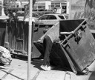


Transfer our questioning to different contexts
What type of human behaviour and decision-making does the photo suggest?
What ethical dimension is being shown?
What ethical issues do you think this picture relates to locally or globally right now?

Slide 7
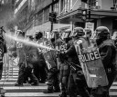

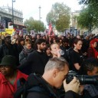


Now exploring one theme.
What ethical issue is depicted?
What are the local or global stories of the issue?
What different cultures are shown?
Are there differences of perception here?
What ethical issues do you think this picture relates to locally or globally right now?

Slide 8

Choose one of the photos here as a stimulus to find 2-3 further photos that share an ethical dimension or specific ethical issue.
Explore: What connects the images you have chosen? How do they show different perspectives? Whose perspective do you most relate to? Can you identify different people/ business/ governments/ bodies that are involved in this issue? How are different cultures involved?
Forming a position: What do you think about it personally? Can you back this up with evidence?

Slide 9
Action
Take three ‘stakeholders’ in the issue you have uncovered. Write a short piece in the first person where you try to present the point of view they might hold.
Forming a position: How does this impact what you think about the issue?

Slide 10
Reflect
How challenging did you find this exercise? Were your responses balanced? What challenges might there be in presenting multiple perspectives in your reflective project? What do you need to present different perspectives in a balanced way?
Forming a position: If you already had a strong point of view, how easy was it to consider other perspectives? If you did not have a strong position at the start, how did you find your own opinion growing?

Slide 11
Share
Looking back on this exercise, talk to a partner and share not just your results from the exercise but where you found it easy or difficult to think from certain perspectives.

Slide 12
Transfer! Go back to the picture at the start. How might you approach these questions now? Which question is the most important one? What questions are missing?
What is the story?
What is the untold story?
What is your story?
What is his/her story?
What is our story?
What is the bigger story?
What is the smaller story?
What is the scientific/historical/cultural story?
What do each of these questions make you consider?
What position do you hold on the ethical issue and dilemma suggested by this picture?
How does this matter to you? How does this matter to your community? How does it matter to the world?

Slide 13

Taking a step back: reflecting on the process
1. Consider the exploration you have just taken part in. How did you use the following skills? Which skill stood out as most impactful?
Communication (Interpersonal) Ethical decision-making (Thinking) Creative Thinking (Thinking) Empathy (Intercultural Understanding)
2. How do you feel you responded to PPS LO5?
LO5 - Demonstrate an awareness of the ethical implications of one’s choices and actions on self and others
3. How might your skill development here link to other elements of your personal and professional contexts?
You might consider Community Engagement or personal and professional contexts

