Slide 1



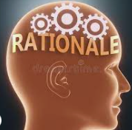

Part 1: How do I understand AI?
Update your IB Learning Journals
Success Criteria:
I can analyze the benefits and challenges of AI and its ethical integration into my own learning.
I can effectively engineer prompts to best utilize generative AI.
I can identify the limitations and cautions of AI and how best handle these issues.
Today’s Agenda:
AI and You
Check In: Where do you stand with AI?
Check On: AI vocabulary sort
Check Out: Understanding AI and its impact on you.
Why is this important?
Understanding AI and its development will help you to determine the best ways to use it ethically and responsibly.
AI will become a very prominent part of our personal and professional lives and knowing the ways it impacts us is critical to our mental wellbeing.

Slide 2
AI and You

Slide 3

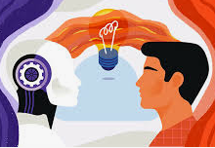
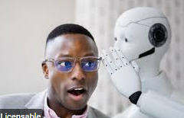

Four corners: Who are you when it comes to using AI?
AI Resistant: Skeptical of AI’s role in my education; hesitant to adopt new technologies.
AI Curious: Interested in exploring AI tools, but cautious about implementation.
AI Embracing: Open to integrating AI into my learning; actively seeking opportunities to use it.
AI Leading: Champion of AI in my learning, actively seeking innovative AI-powered strategies.

Slide 4
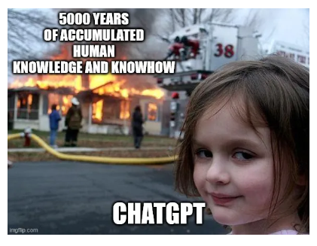
There are two ends of the spectrum…
The person, who feels helpless and worried AI or are there other perspectives at the other end of the spectrum?
How are you feeling about AI at this point in time?

Slide 5
AI Checker
Think about your own experience and usage of AI. Then answer, how many people have used AI…
Today?
Last 24 Hours?
Last 3 days?
Last week?
Last month?
What are you using?

Slide 6
Brief History of AI - AI has been around for a while!
AI has been around since the 1950s (originally cybernetics)
The term AI was coined at Dartmouth
First chatbot launched in the 1960s (ELIZA- a mental health chatbot- repeats your questions … that’s it!)
Machine Learning: Expensive, lots of data, need a lot of information to work properly
Deep Learning: 2016 - Machines really aren’t working, so take all of the data (internet) and change it into probability machines (they make connections from code, visuals, music, text, etc)
Generative AI: Basically generating new and novel output, but it has been trained to do so.

Slide 7
AI Vocabulary: Terms to Know
How many terms do you know?
Artificial Intelligence (AI) Machine Learning (ML) Algorithm
Generative AI Large Language Model (LLM)
Prompt Prompt Engineering Hallucination
Dataset Bias Reinforcement Learning
…. could you define them?

Slide 8
AI Vocabulary: Terms to Know Can you match the terms with the definitions?
Term | Definition
 | The broad field of computer science focused on creating machines that can perform tasks that would typically require human intelligence, such as learning, problem-solving, and decision-making. Think of it as the ultimate goal: building "smart" machines.
 | A subfield of AI where computers learn from data without being explicitly programmed for every task. Instead of following a rigid set of rules, the machine identifies patterns and makes predictions on its own. It's like teaching a child by example rather than by giving them a rulebook.
 | A set of step-by-step instructions or rules that a computer follows to solve a problem or complete a task. In AI, algorithms are the foundation for how a machine learns and makes decisions.
 | A type of AI that can create new, original content like text, images, music, or code. These models learn from massive amounts of existing data and then generate something similar but novel. ChatGPT and Midjourney are examples of generative AI tools.
 | A powerful type of AI model that has been trained on a huge amount of text data from the internet. This training allows it to understand, generate, and process human language in a coherent and contextually relevant way. LLMs are the technology behind most chatbots and writing assistants.
 | The input or command you give to an AI model, usually in the form of text. The quality and specificity of your prompt directly influence the quality of the AI's response.
 | The practice of crafting and refining the instructions you give to an AI model to get a better, more accurate, or more specific response. It's essentially the art and science of "talking" to an AI.
 | When an AI model generates an incorrect, nonsensical, or made-up response that it presents as a factual answer. This happens because the AI is trained to predict the most likely sequence of words, not to verify information.
 | A collection of digital information, like texts, images, or numbers, that is used to train an AI model. The size, quality, and diversity of a dataset are critical for a model's performance and accuracy.
 | An unfair or inaccurate outcome from an AI model that results from flawed or unrepresentative training data. For example, if a model is trained on data that overrepresents one demographic group, it may perform poorly or make biased decisions when interacting with others.
 | A training method where an AI learns through trial and error. The model is given a goal and is "rewarded" for good actions and "penalized" for bad ones, which helps it learn the best way to achieve its objective. Think of it like training a dog with treats.
Prompt Engineering Large Language Model (LLM) Artificial Intelligence (AI) Generative AI Prompt Dataset Bias Reinforcement Learning Hallucination Machine Learning (ML) Algorithm

Slide 9
AI Vocabulary: Terms to Know The terms with the definitions.
Term | Definition
Artificial Intelligence (AI) | The broad field of computer science focused on creating machines that can perform tasks that would typically require human intelligence, such as learning, problem-solving, and decision-making. Think of it as the ultimate goal: building "smart" machines.
Machine Learning (ML) | A subfield of AI where computers learn from data without being explicitly programmed for every task. Instead of following a rigid set of rules, the machine identifies patterns and makes predictions on its own. It's like teaching a child by example rather than by giving them a rulebook.
Algorithm | A set of step-by-step instructions or rules that a computer follows to solve a problem or complete a task. In AI, algorithms are the foundation for how a machine learns and makes decisions.
Generative AI | A type of AI that can create new, original content like text, images, music, or code. These models learn from massive amounts of existing data and then generate something similar but novel. ChatGPT and Midjourney are examples of generative AI tools.
Large Language Model (LLM) | A powerful type of AI model that has been trained on a huge amount of text data from the internet. This training allows it to understand, generate, and process human language in a coherent and contextually relevant way. LLMs are the technology behind most chatbots and writing assistants.
Prompt | The input or command you give to an AI model, usually in the form of text. The quality and specificity of your prompt directly influence the quality of the AI's response.
Prompt Engineering | The practice of crafting and refining the instructions you give to an AI model to get a better, more accurate, or more specific response. It's essentially the art and science of "talking" to an AI.
Hallucination | When an AI model generates an incorrect, nonsensical, or made-up response that it presents as a factual answer. This happens because the AI is trained to predict the most likely sequence of words, not to verify information.
Dataset | A collection of digital information, like texts, images, or numbers, that is used to train an AI model. The size, quality, and diversity of a dataset are critical for a model's performance and accuracy.
Bias | An unfair or inaccurate outcome from an AI model that results from flawed or unrepresentative training data. For example, if a model is trained on data that overrepresents one demographic group, it may perform poorly or make biased decisions when interacting with others.
Reinforcement Learning | A training method where an AI learns through trial and error. The model is given a goal and is "rewarded" for good actions and "penalized" for bad ones, which helps it learn the best way to achieve its objective. Think of it like training a dog with treats.

Slide 10
AI Vocabulary: Terms to Know
Discuss: Could you group the terms to show their relationships to one another?
Be prepared to explain your organisational structure to someone else.

Slide 11
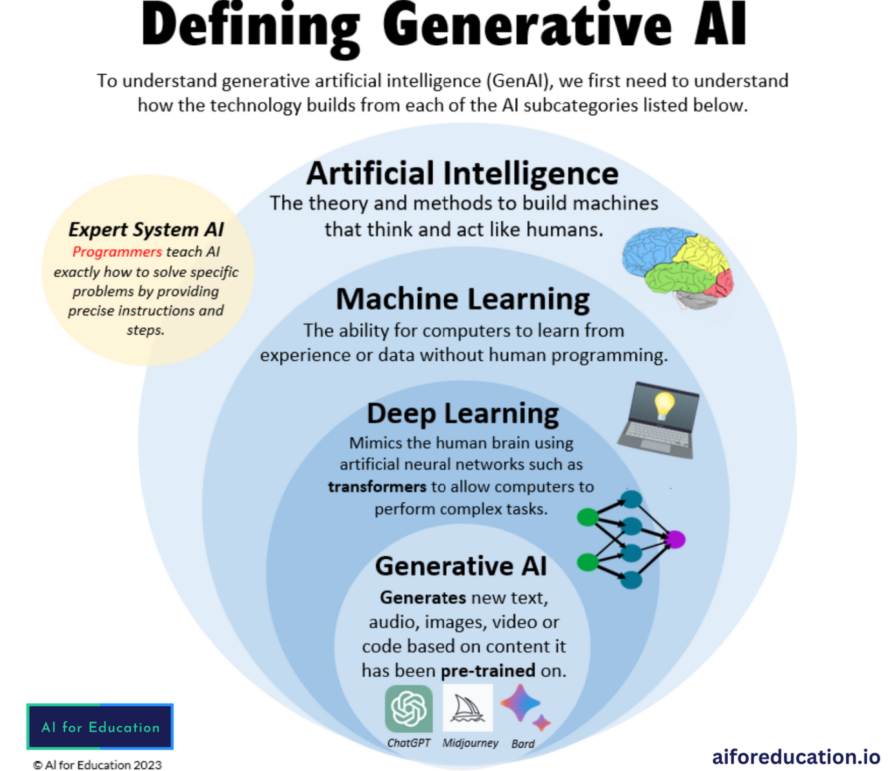

Slide 12
Rapid Rate of AI Growth
It took a long time to get to this point…
1960 to today…
BUT…

Slide 13
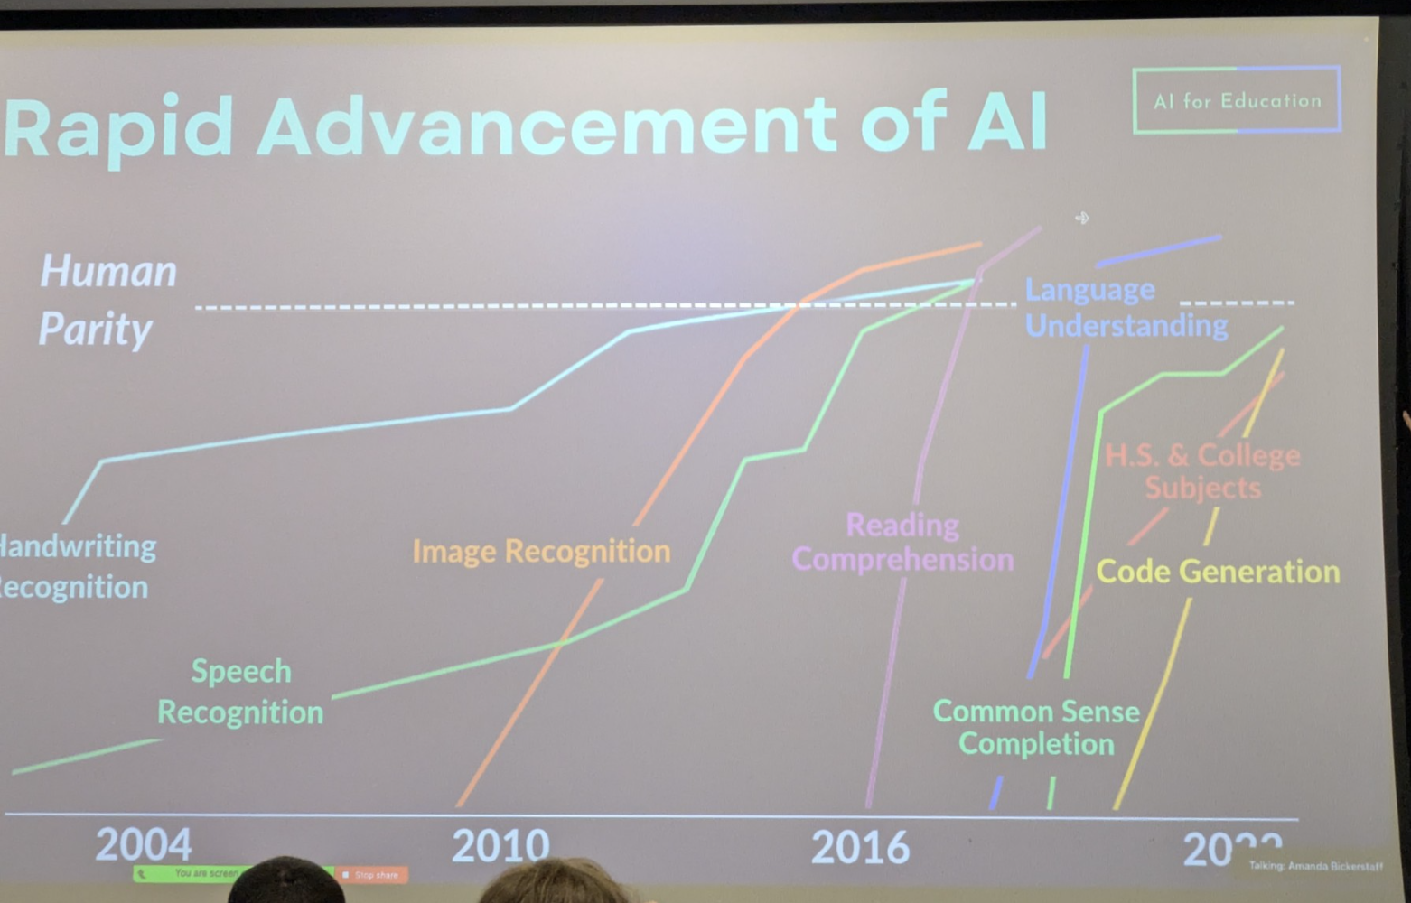

Slide 14
What does this mean
for you?

Slide 15
Using AI Responsibly: Be a good human!
We need to learn the following:
Prompt Engineering
AI’s limitations (and caution)
Acceptable Use of AI
  In PPS Class
  In IB, especially the Reflective Project
Proper ways to cite AI usage in your work

