Slide 1
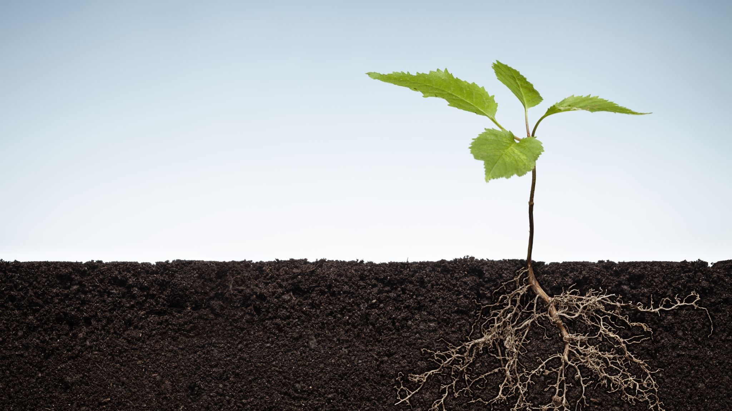
Inquiry 6: Recognising and reflecting on growth
Supporting student inquiry: Who am I becoming?

Slide 2

What is progress and how do we talk about it?
How could we talk about it?

Slide 3
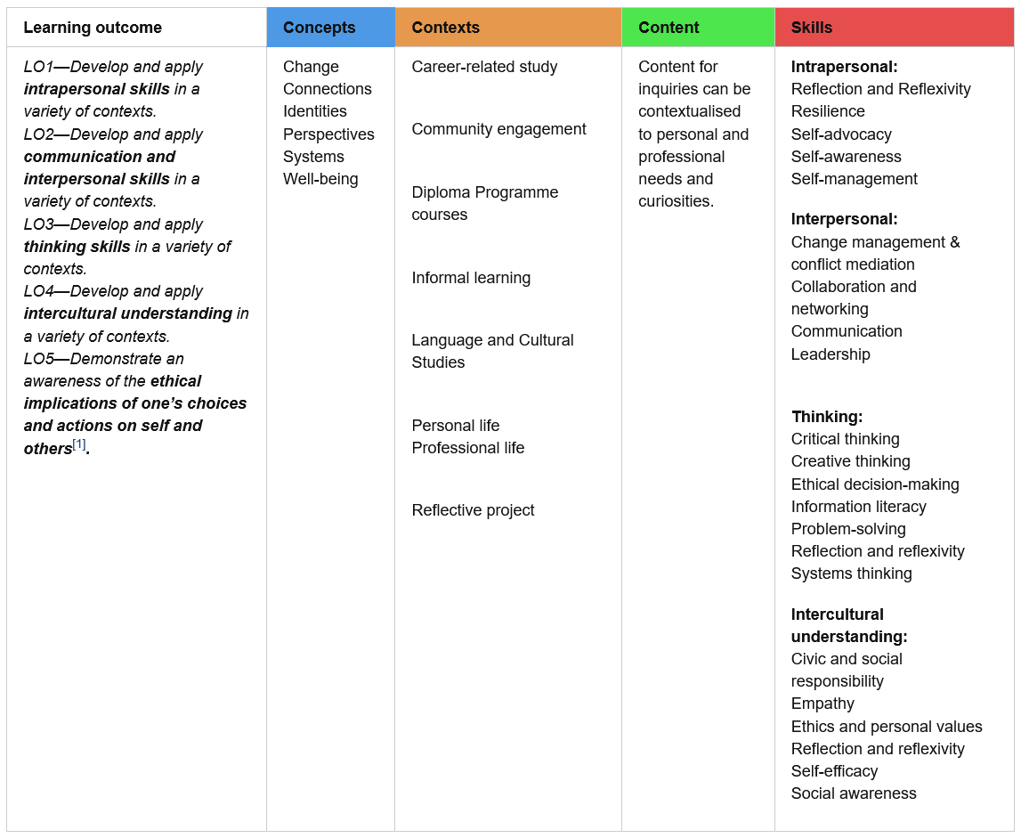
Which learning outcomes, concepts, contexts, skill domains and transversal skills jump out at you as areas you feel you are regularly exploring?
Which ones do you feel you are really progressing in?
Which ones are you struggling with? Are there some areas where you struggle with it more than others?
Are there any you do not feel you have accessed at all yet?

Slide 4
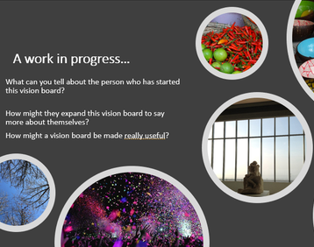
Remember your vision board ‘who am i?’
Where did your focus lie? How would you add to it now? Could you extend your vision board to capture your past, present and future? Have any of your priorities changed?
Pick someone you feel comfortable talking to about your vision board review.
Use the thinking routine 'I used to think ... but now I think... And that might mean' as a way of structuring your thoughts about who you are becoming and how you think you are changing.

Slide 5
How do we deepen our thinking?
It’s important to go beyond shallow judgements and labels about people, systems, objects, or ideas. To do this, we need:
Time: take a moment to consider what you really think and not rush to make a decision.
Scaffold: You can keep building your ideas over time and notice how your ideas about who you are change and mature.

Slide 6

Try this in your learning journal:
Think about who you are and then about someone else.
Explore: Who am I? How has my identity developed?
Connect: eg I am connected to my parents, their parents and my brother and sister and I'm in the basketball team. Who else and what else am I connected to? What else shapes my identity?
Identify: If I wanted other to know who I am, what would identify me? Do we have more than one identity?
Belong: Where do I think i belong? Do I have a sense of belonging to more that one group, more than on place?
Reflect: How does this exercise consider your strengths and areas for growth?

Slide 7
Reflect on the last year
1. If you could pick 5 words to describe the last year, what would they be?
2. When did you feel most comfortable and at ease over this past year?
3. What are you most grateful for?
4. What were the hardest challenges in the last year?
5. What have you learnt about your values? Have they changed? Have you become more aware of what they are?
6. What relationships have been the most important to you? Have you forged new ones?
7. Who uplifts and inspires you? Why?
8. What could you have done this last year differently?
9. Name three things that make you happy?
10. Finish this sentence: This time next year, I hope to feel ...
Remember the Learner Profile is a useful tool to help you identify the characteristics you are developing or noticing playing a part in your progress

Slide 8

Curate your response and share

Slide 9
Using the learning outcomes as your lens, create a presentation in any format entitled ‘Who I am becoming’.
LO1—Develop and apply intrapersonal skills in a variety of contexts.
LO2—Develop and apply communication and interpersonal skills in a variety of context
LO3 – Develop and apply thinking skills in a variety of contexts
LO4—Develop and apply intercultural understanding in a variety of contexts.
LO5 - Demonstrate an awareness of the ethical implications of one’s choices and actions on self and others

Slide 10
How will you share your findings from this inquiry?
Consider a written, visual, audio, or audio-visual format you would like to communicate your progress in and define the purpose, audience, language and structure you will use.
Which one will you use and why?

