Slide 1





Learning journal: An exploration of the principles of engagement through Community Engagement brainstorming activity.
What is active community engagement?
Success Criteria:
I can define ENGAGEMENT.
I can define the terms of dialogue, reciprocity and reflexivity.
I can apply principles of engagement.
Today’s Agenda:
Community Engagement (CE)
Check In: What is engagement?
Check On: Exploring your engagement with your communities
Check Out: The CE engagement outcomes and definitions.
Why is this important?
Engaging with community leads to personal development to make a local and global difference.

Slide 2

COMMUNITY ENGAGEMENT
Community Engagement
What is active engagement?
Notes:
Consider IB Learner Profile while you do your CE.

Slide 3
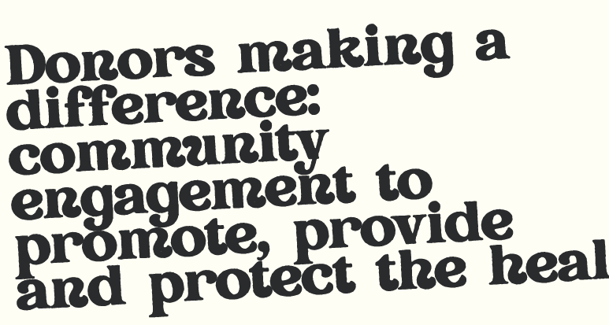
Look at the following headline
What does this suggest about the different factors involved in community engagement? What perspectives might people hold about how to contribute to society?

Slide 4
What creates success in community engagement?
Uganda trains district health workers on community-based approach to Ebola
Community engagement for access to health services in Lao PDR
Côte d'Ivoire community radios boost public awareness on mpox outbreak
Bolivia strengthens social participation in health for indigenous population
Weaving hope in Honduras: the community wisdom that saves lives
Grassroots heroes in Cambodia
Bolstering public awareness to help curb mpox spread in Uganda
Combating measles: a comprehensive community-centred approach in Ethiopia
WHO races to contain malaria resurgence in southeastern Iran
Mali: screening for malnutrition in affected children to avoid complications
Effective community engagement saving lives in Tanzania during cholera outbreak
Pick a headline and consider how you think this community project became successful. What action would you take in these scenarios to engage the community?

Slide 5
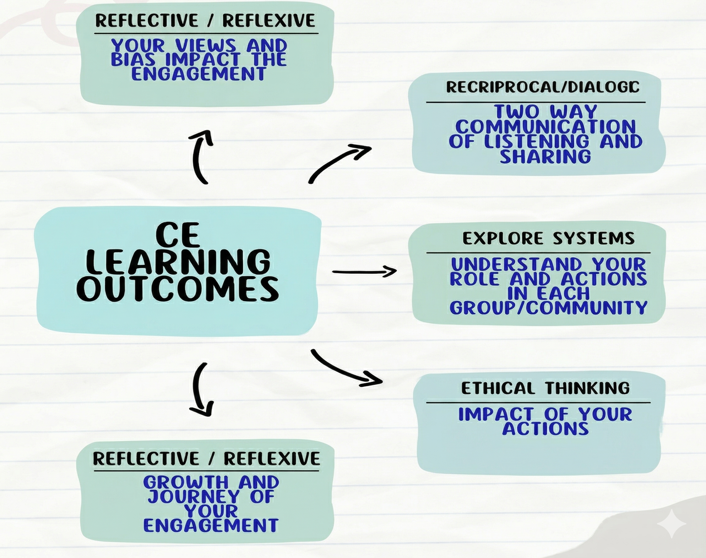
What do these learning outcomes suggest about what engagement in the community is?
Notes:
*Share out - groups of 5 (5 minutes)

Slide 6
What is Community Engagement all about?
It means moving beyond awareness to take action that creates meaningful change for a sustainable future.

Slide 7
Take 4 post-its - write the following terms on each post it:
Reciprocity, Dialogue, Reflection, Reflexivity
Come up with a definition for each
Compare your response with a peer and come up with a definition together.

Slide 8
Now match Reciprocity, Dialogue, Reflection, Reflexivity with the definitions below. Then compare your own definition with these. Where do you match? Where could you add more?
Thinking deeply about situations, thoughts and actions to make positive changes while being open to discomfort.
Building partnerships with communities based on respect and consent while practising fairness and accountability to ensure everyone has an equal voice and responsibility in creating change.
Listen respectfully, embrace different perspectives without judgment, and work together to build shared understanding and goals.
Carefully questioning your own assumptions, biases, and attitudes to see how they shape your views and actions, while approaching others with openness and humility

Slide 9
Principles of Engagement IB Definition: Reciprocity
Building and understanding complexity of relationships
Relating to communities as partners and allies
Creating an environment where all learn from each other and can contribute and grow
Cultivating and practicing compassion and ethical solidarity
Working to distribute power and accountability equitably between all partners
Collectively defining shared purpose and co-creating visions
Notes:
With a partner -- re-state in your own words

Slide 10
Principles of Engagement: Reciprocity
Building partnerships with communities based on respect and consent while practising fairness and accountability to ensure everyone has an equal voice and responsibility in creating change.
Notes:
Equal and fair “give and take”

Slide 11
Principles of Engagement IB Definition: Dialogue
Listening with attention and respect
Recognising and holding different perspectives without judgment
Creating shared understanding and goals
Notes:
With a partner -- re-state in your own words

Slide 12
Principles of Engagement Dialogue
Listen respectfully, embrace different perspectives without judgment, and work together to build shared understanding and goals.
Notes:
Not just talk - but listen to learn

Slide 13
Principles of Engagement IB Definition: Reflection
Combining critical analysis with the ability to embrace potential discomfort and capacity to take action
Awareness of learning process and examining thinking, feelings, intentions, and actions
Notes:
With a partner -- re-state in your own words

Slide 14
Principles of Engagement: Reflection
Thinking deeply about situations, thoughts and actions to make positive changes while being open to discomfort.

Slide 15
Principles of Engagement IB Definition: Reflexivity
Critical examining assumptions, bias, attitudes and these influence perceptions and actions
Approaching people and situations with openness, humility, and critical curiosity.
Notes:
With a partner -- re-state in your own words

Slide 16
Principles of Engagement: Reflexivity
Carefully questioning your own assumptions, biases, and attitudes to see how they shape your views and actions, while approaching others with openness and humility.

Slide 17

Community Engagement Brainstorm
Using the template for Community Engagement Brainstorming:
identify 3 communities
explain your ideas for engagement
make notes on how you can foster reciprocal and dialogic engagement with them.
Discuss your ideas with a partner/group and give feedback to each other on what is great and ‘glows’ and what could develop further and ‘grow’

Slide 18
And finally …
Come full circle: Revisit the article from the first stage of this inquiry. Now you have explored what dialogue, reciprocity, reflection and reflexivity mean in active community engagement, where can you see these playing a part in the examples given here.
World Health Organisation projects article
Can you find further examples?

